Slide 1
Database Management System (MDS 505)
Jagdish Bhatta
Jagdish Bhatta

Slide 2
Unit – 5.1
Transaction Processing
Jagdish Bhatta
Notes:
Jagidsh Bhatta

Slide 3
Single User Vs. Multi-User System
One criterion for classifying a database system is according to the number of users who can use the system concurrently. A DBMS is single-user if at most one user at a time can use the system, and it is multiuser if many users can use the system— and hence access the database—concurrently. Single-user DBMSs are mostly restricted to personal computer systems; most other DBMSs are multiuser. For example, an airline reservations system is used by hundreds of users and travel agents concurrently.
Database systems used in banks, insurance agencies, stock exchanges, supermarkets, and many other applications are multiuser systems. In these systems, hundreds or thousands of users are typically operating on the database by submitting transactions concurrently to the system.
Jagdish Bhatta
Notes:
Jagidsh Bhatta

Slide 4
Transactions, Database Items, Read
and Write Operations, and DBMS Buffers
A transaction is an executing program that forms a logical unit of database processing.
A transaction includes one or more database access operations—these can include insertion, deletion, modification (update), or retrieval operations.
The database operations that form a transaction can either be embedded within an application program or they can be specified interactively via a high-level query language such as SQL.
Jagdish Bhatta
Notes:
Jagidsh Bhatta

Slide 5
Transactions, Database Items, Read
and Write Operations, and DBMS Buffers
One way of specifying the transaction boundaries is by specifying explicit begin transaction and end transaction statements in an application program; in this case, all database access operations between the two are considered as forming one transaction. A single application program may contain more than one transaction if it contains several transaction boundaries.
If the database operations in a transaction do not update the database but only retrieve data, the transaction is called a read-only transaction; otherwise it is known as a read-write transaction.
Jagdish Bhatta
Notes:
Jagidsh Bhatta

Slide 6
Transactions, Database Items, Read
and Write Operations, and DBMS Buffers
The database model that is used to present transaction processing concepts is simple when compared to the data models that we discussed earlier, such as the relational model or the object model.
A database is basically represented as a collection of named data items. The size of a data item is called its granularity. A data item can be a database record, but it can also be a larger unit such as a whole disk block, or even a smaller unit such as an individual field (attribute) value of some record in the database. The transaction processing concepts we discuss are independent of the data item granularity (size) and apply to data items in general.
Jagdish Bhatta
Notes:
Jagidsh Bhatta

Slide 7
Transactions, Database Items, Read
and Write Operations, and DBMS Buffers
Each data item has a unique name, but this name is not typically used by the programmer; rather, it is just a means to uniquely identify each data item. For example, if the data item granularity is one disk block, then the disk block address can be used as the data item name. If the item granularity is a single record, then the record id can be the item name.
Jagdish Bhatta
Notes:
Jagidsh Bhatta

Slide 8
Transactions, Database Items, Read
and Write Operations, and DBMS Buffers
The basic database access operations that a transaction can include are as follows:
  read_item(X). Reads a database item named X into a program variable. To simplify our notation, we assume that the program variable is also named X.
  write_item(X). Writes the value of program variable X into the database item named X.
Jagdish Bhatta
Notes:
Jagidsh Bhatta

Slide 9
Transactions, Database Items, Read
and Write Operations, and DBMS Buffers
Executing a read_item(X) command includes the following steps:
  Find the address of the disk block that contains item X.
  Copy that disk block into a buffer in main memory (if that disk block is not already in some main memory buffer). The size of the buffer is the same as the disk block size.
  Copy item X from the buffer to the program variable named X.
Executing a write_item(X) command includes the following steps:
  Find the address of the disk block that contains item X.
  Copy that disk block into a buffer in main memory (if that disk block is not already in some main memory buffer).
  Copy item X from the program variable named X into its correct location in the buffer.
  Store the updated disk block from the buffer back to disk (either immediately or at some later point in time).
Jagdish Bhatta
Notes:
Jagidsh Bhatta

Slide 10
Transactions, Database Items, Read
and Write Operations, and DBMS Buffers
In write_item(X) command, It is step 4 that actually updates the database on disk. Sometimes the buffer is not immediately stored to disk, in case additional changes are to be made to the buffer. Usually, the decision about when to store a modified disk block whose contents are in a main memory buffer is handled by the recovery manager of the DBMS in cooperation with the underlying operating system.
The DBMS will maintain in the database cache a number of data buffers in main memory. Each buffer typically holds the contents of one database disk block, which contains some of the database items being processed. When these buffers are all occupied, and additional database disk blocks must be copied into memory, some buffer replacement policy is used to choose which of the current occupied buffers is to be replaced.
Jagdish Bhatta
Notes:
Jagidsh Bhatta

Slide 11
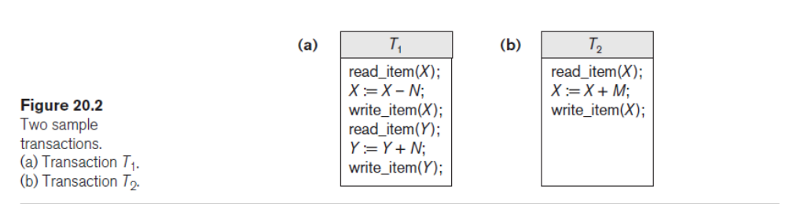
Transactions, Database Items, Read
and Write Operations, and DBMS Buffers
A transaction includes read_item and write_item operations to access and update the database. Following shows examples of two very simple transactions. The read-set of a transaction is the set of all items that the transaction reads, and the write-set is the set of all items that the transaction writes. For example, the read-set of T1 in the figure is {X, Y} and its write-set is also {X, Y}.
Jagdish Bhatta
Notes:
Jagidsh Bhatta

Slide 12
Why Concurrency Control Is Needed?
Concurrency control and recovery mechanisms are mainly concerned with the database commands in a transaction. Transactions submitted by the various users may execute concurrently and may access and update the same database items.
If this concurrent execution is uncontrolled, it may lead to problems, such as an inconsistent database. In the next section, we informally introduce some of the problems that may occur.
Jagdish Bhatta
Notes:
Jagidsh Bhatta

Slide 13
Why Concurrency Control Is Needed?
Generally, database system allows multiple transactions to run concurrently. Concurrent execution of transaction in database system improves database system performance, reducing transaction waiting time to proceed. It improves resource utilization. But it may lead the database in inconsistent state due to interference among actions of concurrent transactions. Concurrent execution of transaction in database system leads several concurrency control problems.
Jagdish Bhatta
Notes:
Jagidsh Bhatta

Slide 14
Why Concurrency Control is needed?
With concurrent execution of transactions, if they are allowed to execute in uncontrolled manner several problems may occur such as;
The Lost Update Problem: This occurs when two transactions that access the same database items have their operations interleaved in a way that makes the value of some database item incorrect.
Jagdish Bhatta
Notes:
Jagidsh Bhatta

Slide 15
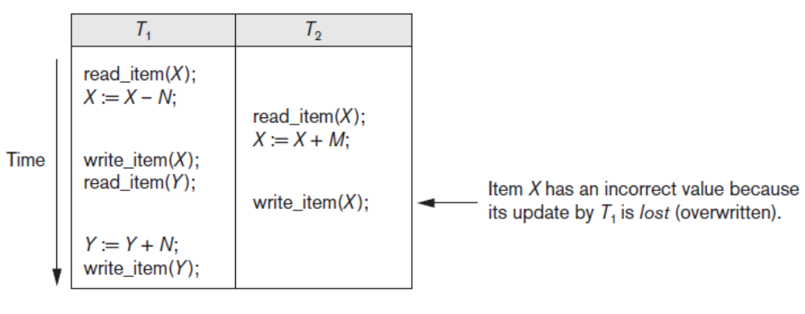
Why Concurrency Control is needed?
The Lost Update Problem: Suppose that transactions T1 and T2 are submitted at approximately the same time, and suppose that their operations are interleaved as shown in following figure; then the final value of item X is incorrect because T2 reads the value of X before T1 changes it in the database, and hence the updated value resulting from T1 is lost. For example, if X = 80 at the start, N = 5, and M = 4, the final result should be X = 79. However, in the interleaving of operations shown in the figure, it is X = 84 because the update in T1 that removed the five seats from X was lost.
Jagdish Bhatta
Notes:
Jagidsh Bhatta

Slide 16
Why Concurrency Control is needed?
The Temporary Update (or Dirty Read) Problem: This occurs when one transaction updates a database item and then the transaction fails for some reason. The updated item is accessed by another transaction before it is changed back to its original value.
Jagdish Bhatta
Notes:
Jagidsh Bhatta

Slide 17
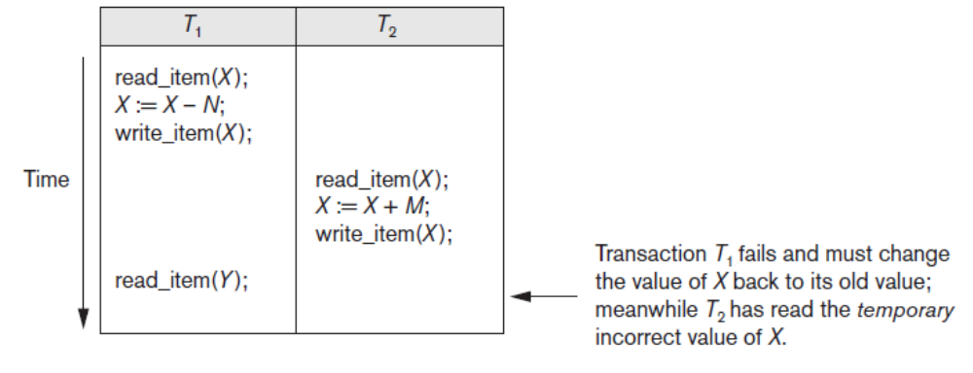
Why Concurrency Control is needed?
The Temporary Update (or Dirty Read) Problem: Following Figure shows an example where T1 updates item X and then fails before completion, so the system must roll back X to its original value. Before it can do so, however, transaction T2 reads the temporary value of X, which will not be recorded permanently in the database because of the failure of T1. The value of item X that is read by T2 is called dirty data because it has been created by a transaction that has not completed and committed yet; hence, this problem is also known as the dirty read problem.
Jagdish Bhatta
Notes:
Jagidsh Bhatta

Slide 18
Why Concurrency Control is needed?
The Incorrect Summary Problem.: If one transaction is calculating an aggregate summary function on a number of records while other transactions are updating some of these records, the aggregate function may calculate some values before they are updated and others after they are updated.
Jagdish Bhatta
Notes:
Jagidsh Bhatta

Slide 19
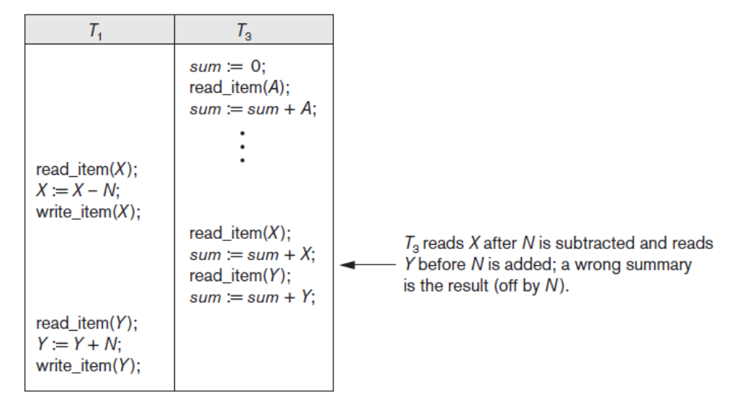
Why Concurrency Control is needed?
The Incorrect Summary Problem: For example, suppose that a transaction T3 is calculating the sum; meanwhile, transaction T1 is executing. If the interleaving of operations shown in following figure occurs, the result of T3 will be off by an amount N because T3 reads the value of X after N have been subtracted from it but reads the value of Y before those N have been added to it.
Jagdish Bhatta
Notes:
Jagidsh Bhatta

Slide 20
Why Concurrency Control is needed?
The Unrepeatable read problem:
Another problem that may occur is called unrepeatable read, where a transaction T reads the same item twice and the item is changed by another transaction T′ between the two reads. Hence, T receives different values for its two reads of the same item.
This may occur, for example, if during an airline reservation transaction, a customer inquires about seat availability on several flights. When the customer decides on a particular flight, the transaction then reads the number of seats on that flight a second time before completing the reservation, and it may end up reading a different value for the item.
Jagdish Bhatta
Notes:
Jagidsh Bhatta

Slide 21
Why Recovery Is Needed?
Whenever a transaction is submitted to a DBMS for execution, the system is responsible for making sure that either all the operations in the transaction are completed successfully and their effect is recorded permanently in the database, or that the transaction does not have any effect on the database or any other transactions. In the first case, the transaction is said to be committed, whereas in the second case, the transaction is aborted. The DBMS must not permit some operations of a transaction T to be applied to the database while other operations of T are not, because the whole transaction is a logical unit of database processing. If a transaction fails after executing some of its operations but before executing all of them, the operations already executed must be undone and have no lasting effect.
Jagdish Bhatta
Notes:
Jagidsh Bhatta

Slide 22
Why Recovery is needed?
Types of Failures. Failures are generally classified as transaction, system, and media failures. There are several possible reasons for a transaction to fail in the middle of execution:
  A computer failure (system crash): A hardware, software, or network error occurs in the computer system during transaction execution. Hardware crashes are usually media failures—for example, main memory failure.
  A transaction or system error: Some operation in the transaction may cause it to fail, such as integer overflow or division by zero. Transaction failure may also occur because of erroneous parameter values or because of a logical programming error. Additionally, the user may interrupt the transaction during its execution.
  Local errors or exception conditions detected by the transaction. During transaction execution, certain conditions may occur that necessitate cancellation of the transaction. For example, data for the transaction may not be found. An exception condition, such as insufficient account balance in a banking database, may cause a transaction, such as a fund withdrawal, to be canceled. This exception could be programmed in the transaction itself, and in such a case would not be considered as a transaction failure.
Jagdish Bhatta
Notes:
Jagidsh Bhatta

Slide 23
Why Recovery is needed?
Types of Failures:
  Concurrency control enforcement. The concurrency control method may abort a transaction because it violates serializability, or it may abort one or more transactions to resolve a state of deadlock among several transactions. Transactions aborted because of serializability violations or deadlocks are typically restarted automatically at a later time.
  Disk failure. Some disk blocks may lose their data because of a read or write malfunction or because of a disk read/write head crash. This may happen during a read or a write operation of the transaction.
  Physical problems and catastrophes. This refers to an endless list of problems that includes power or air-conditioning failure, fire, theft, sabotage, overwriting disks or tapes by mistake, and mounting of a wrong tape by the operator.
Failures of types 1, 2, 3, and 4 are more common than those of types 5 or 6. Whenever a failure of type 1 through 4 occurs, the system must keep sufficient information to quickly recover from the failure. Disk failure or other catastrophic failures of type 5 or 6 do not happen frequently; if they do occur, recovery is a major task.
Jagdish Bhatta
Notes:
Jagidsh Bhatta

Slide 24
Transaction and System Concepts
Transaction States and Operations
A transaction is an atomic unit of work that should either be completed in its entirety or not done at all. For recovery purposes, the system needs to keep track of when each transaction starts, terminates, and commits, or aborts. Therefore, the recovery manager of the DBMS needs to keep track of the following operations:
  BEGIN_TRANSACTION. This marks the beginning of transaction execution.
  READ or WRITE. These specify read or write operations on the database items that are executed as part of a transaction.
  END_TRANSACTION. This specifies that READ and WRITE transaction operations have ended and marks the end of transaction execution. However, at this point it may be necessary to check whether the changes introduced by the transaction can be permanently applied to the database (committed) or whether the transaction has to be aborted because it violates serializability or for some other reason.
  COMMIT_TRANSACTION. This signals a successful end of the transaction so that any changes (updates) executed by the transaction can be safely committed to the database and will not be undone.
  ROLLBACK (or ABORT). This signals that the transaction has ended unsuccessfully, so that any changes or effects that the transaction may have applied to the database must be undone.
Jagdish Bhatta
Notes:
Jagidsh Bhatta

Slide 25
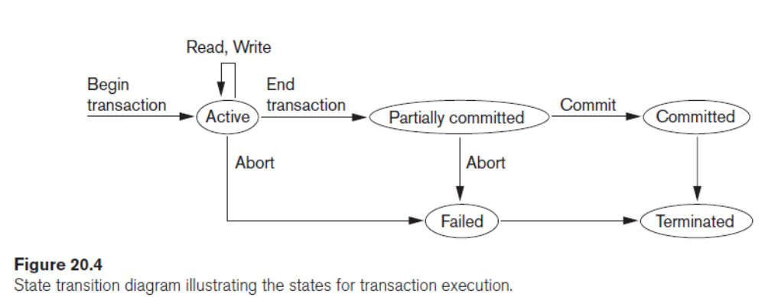
Transaction and System Concepts
Transaction States and Operations
Jagdish Bhatta
Notes:
Jagidsh Bhatta

Slide 26
Transaction and System Concepts
Transaction States and Operations
A state transition diagram that illustrates how a transaction moves through its execution states. A transaction goes into an active state immediately after it starts execution, where it can execute its READ and WRITE operations.
When the transaction ends, it moves to the partially committed state. At this point, some types of concurrency control protocols may do additional checks to see if the transaction can be committed or not. Also, some recovery protocols need to ensure that a system failure will not result in an inability to record the changes of the transaction permanently (usually by recording changes in the system log).
If these checks are successful, the transaction is said to have reached its commit point and enters the committed state.. When a transaction is committed, it has concluded its execution successfully and all its changes must be recorded permanently in the database, even if a system failure occurs.
Jagdish Bhatta
Notes:
Jagidsh Bhatta

Slide 27
Transaction and System Concepts
Transaction States and Operations
However, a transaction can go to the failed state if one of the checks fails or if the transaction is aborted during its active state. The transaction may then have to be rolled back to undo the effect of its WRITE operations on the database.
The terminated state corresponds to the transaction leaving the system. The transaction information that is maintained in system tables while the transaction has been running is removed when the transaction terminates. Failed or aborted transactions may be restarted later—either automatically or after being resubmitted by the user—as brand new transactions
Jagdish Bhatta
Notes:
Jagidsh Bhatta

Slide 28
Transaction and System Concepts
The System Log
To be able to recover from failures that affect transactions, the system maintains a log to keep track of all transaction operations that affect the values of database items, as well as other transaction information that may be needed to permit recovery from failures. The log is a sequential, append-only file that is kept on disk, so it is not affected by any type of failure except for disk or catastrophic failure. Typically, one (or more) main memory buffers, called the log buffers, hold the last part of the log file, so that log entries are first added to the log main memory buffer. When the log buffer is filled, or when certain other conditions occur, the log buffer is appended to the end of the log file on disk. In addition, the log file from disk is periodically backed up to archival storage (tape) to guard against catastrophic failures.
Jagdish Bhatta
Notes:
Jagidsh Bhatta

Slide 29
Transaction and System Concepts
The System Log
The following are the types of entries—called log records—that are written to the log file and the corresponding action for each log record. In these entries, T refers to a unique transaction-id that is generated automatically by the system for each transaction and that is used to identify each transaction:
  [start_transaction, T]. Indicates that transaction T has started execution.
  [write_item, T, X, old_value, new_value]. Indicates that transaction T has changed the value of database item X from old_value to new_value.
  [read_item, T, X]. Indicates that transaction T has read the value of database item X.
  [commit, T]. Indicates that transaction T has completed successfully, and affirms that its effect can be committed (recorded permanently) to the database.
  [abort, T]. Indicates that transaction T has been aborted.
Jagdish Bhatta
Notes:
Jagidsh Bhatta

Slide 30
Transaction and System Concepts
Commit Point of a Transaction
A transaction T reaches its commit point when all its operations that access the database have been executed successfully and the effect of all the transaction operations on the database have been recorded in the log. Beyond the commit point, the transaction is said to be committed, and its effect must be permanently recorded in the database. The transaction then writes a commit record [commit, T] into the log.
If a system failure occurs, we can search back in the log for all transactions T that have written a [start_transaction, T] record into the log but have not written their [commit, T] record yet; these transactions may have to be rolled back to undo their effect on the database during the recovery process. Transactions that have written their commit record in the log must also have recorded all their WRITE operations in the log, so their effect on the database can be redone from the log records.
Jagdish Bhatta
Notes:
Jagidsh Bhatta

Slide 31
Desirable Properties of Transactions: ACID properties
Atomicity. A transaction is an atomic unit of processing; it should either be performed in its entirety or not performed at all.
The atomicity property requires that we execute a transaction to completion. It is the responsibility of the transaction recovery subsystem of a DBMS to ensure atomicity. If a transaction fails to complete for some reason, such as a system crash in the midst of transaction execution, the recovery technique must undo any effects of the transaction on the database. On the other hand, write operations of a committed transaction must be eventually written to disk.
Jagdish Bhatta
Notes:
Jagidsh Bhatta

Slide 32
Desirable Properties of Transactions: ACID properties
Consistency preservation. A transaction should be consistency preserving, meaning that if it is completely executed from beginning to end without interference from other transactions, it should take the database from one consistent state to another.
The preservation of consistency is generally considered to be the responsibility of the programmers who write the database programs and of the DBMS module that enforces integrity constraints. Recall that a database state is a collection of all the stored data items (values) in the database at a given point in time. A consistent state of the database satisfies the constraints specified in the schema as well as any other constraints on the database that should hold. A database program should be written in a way that guarantees that, if the database is in a consistent state before executing the transaction, it will be in a consistent state after the complete execution of the transaction, assuming that no interference with other transactions occurs.
Jagdish Bhatta
Notes:
Jagidsh Bhatta

Slide 33
Desirable Properties of Transactions: ACID properties
Isolation. A transaction should appear as though it is being executed in isolation from other transactions, even though many transactions are executing concurrently. That is, the execution of a transaction should not be interfered with by any other transactions executing concurrently.
The isolation property is enforced by the concurrency control subsystem of the DBMS. If every transaction does not make its updates (write operations) visible to other transactions until it is committed, one form of isolation is enforced that solves the temporary update problem and eliminates cascading rollbacks but does not eliminate all other problems.
Levels of Isolation. There have been attempts to define the level of isolation of a transaction. A transaction is said to have level 0 (zero) isolation if it does not overwrite the dirty reads of higher-level transactions. Level 1 (one) isolation has no lost updates, and level 2 isolation has no lost updates and no dirty reads. Finally, level 3 isolation (also called true isolation) has, in addition to level 2 properties, repeatable reads.
Jagdish Bhatta
Notes:
Jagidsh Bhatta

Slide 34
Desirable Properties of Transactions: ACID properties
Durability or permanency. The changes applied to the database by a committed transaction must persist in the database. These changes must not be lost because of any failure. The durability property is the responsibility of the recovery subsystem of the DBMS.
Jagdish Bhatta
Notes:
Jagidsh Bhatta

Slide 35
Characterizing Schedules Based on Recoverability
Schedules (Histories) of Transactions: When transactions are executing concurrently in an interleaved fashion, the order of execution of operations from all the various transactions is known as a transaction schedule (or history).
A schedule (or history) S of n transactions T1, T2, … , Tn is an ordering of the operations of the transactions. Operations from different transactions can be interleaved in the schedule S. However, for each transaction Ti that participates in the schedule S, the operations of Ti in S must appear in the same order in which they occur in Ti. The order of operations in S is considered to be a total ordering, meaning that for any two operations in the schedule, one must occur before the other. It is possible theoretically to deal with schedules whose operations form partial orders, but we will assume for now total ordering of the operations in a schedule.
Jagdish Bhatta
Notes:
Jagidsh Bhatta

Slide 36
Characterizing Schedules Based on Recoverability
Schedules (Histories) of Transactions:
A shorthand notation for describing a schedule uses the symbols b, r, w, e, c, and a for the operations begin_transaction, read_item, write_item, end_transaction, commit, and abort, respectively, and appends as a subscript the transaction id (transaction number) to each operation in the schedule. In this notation, the database item X that is read or written follows the r and w operations in parentheses.
Jagdish Bhatta
Notes:
Jagidsh Bhatta

Slide 37
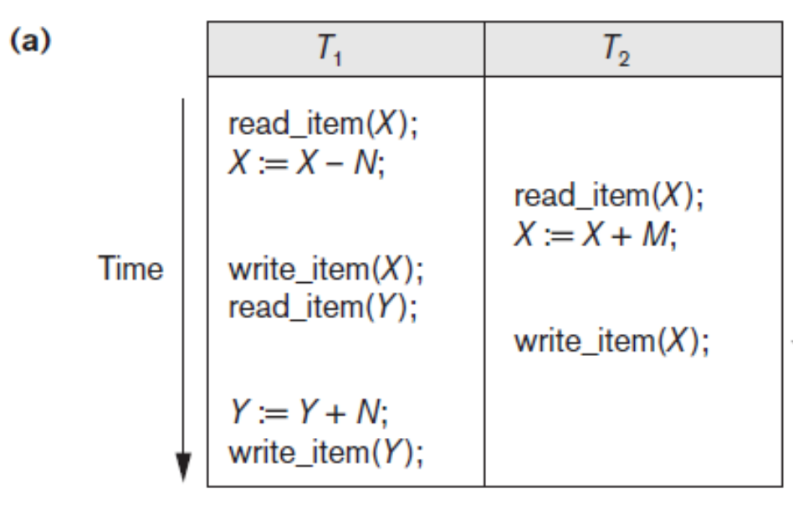
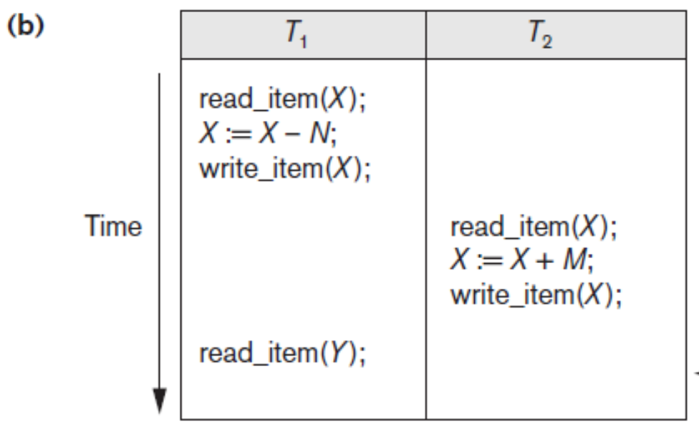
Characterizing Schedules Based on Recoverability
Schedules (Histories) of Transactions:
Sa: r1(X); r2(X); w1(X); r1(Y); w2(X); w1(Y); Sb: r1(X); w1(X); r2(X); w2(X); r1(Y); a1; [Here it is assumed T1 is aborted after read_item(Y)]
Jagdish Bhatta
Notes:
Jagidsh Bhatta

Slide 38
Characterizing Schedules Based on Recoverability
Schedules (Histories) of Transactions:
Conflicting Operations in a Schedule. Two operations in a schedule are said to conflict if they satisfy all three of the following conditions:
  they belong to different transactions;
  they access the same item X; and
  at least one of the operations is a write_item(X).
For example, in schedule Sa, the operations r1(X) and w2(X) conflict, as do the operations r2(X) and w1(X), and the operations w1(X) and w2(X). However, the operations r1(X) and r2(X) do not conflict, since they are both read operations; the operations w2(X) and w1(Y) do not conflict because they operate on distinct data items X and Y; and the operations r1(X) and w1(X) do not conflict because they belong to the same transaction.
Jagdish Bhatta
Notes:
Jagidsh Bhatta

Slide 39
Characterizing Schedules Based on Recoverability
Schedules (Histories) of Transactions:
Intuitively, two operations are conflicting if changing their order can result in a different outcome. For example, if we change the order of the two operations r1(X); w2(X) to w2(X); r1(X), then the value of X that is read by transaction T1 changes, because in the second ordering the value of X is read by r1(X) after it is changed by w2(X), whereas in the first ordering the value is read before it is changed. This is called a read-write conflict.
The other type is called a write-write conflict and is illustrated by the case where we change the order of two operations such as w1(X); w2(X) to w2(X); w1(X). For a write-write conflict, the last value of X will differ because in one case it is written by T2 and in the other case by T1. Notice that two read operations are not conflicting because changing their order makes no difference in outcome.
Jagdish Bhatta
Notes:
Jagidsh Bhatta

Slide 40
Characterizing Schedules Based on Recoverability
Schedules (Histories) of Transactions:
A schedule S of n transactions T1, T2, … , Tn is said to be a complete schedule if the following conditions hold:
  The operations in S are exactly those operations in T1, T2, … , Tn, including a commit or abort operation as the last operation for each transaction in the schedule.
  For any pair of operations from the same transaction Ti, their relative order of appearance in S is the same as their order of appearance in Ti.
  For any two conflicting operations, one of the two must occur before the other in the schedule.
Jagdish Bhatta
Notes:
Jagidsh Bhatta

Slide 41
Characterizing Schedules Based on Recoverability
Schedules (Histories) of Transactions:
In general, it is difficult to encounter complete schedules in a transaction processing system because new transactions are continually being submitted to the system. Hence, it is useful to define the concept of the committed projection C(S) of a schedule S, which includes only the operations in S that belong to committed transactions—that is, transactions Ti whose commit operation ci is in S.
Jagdish Bhatta
Notes:
Jagidsh Bhatta

Slide 42
Characterizing Schedules Based on Recoverability
For some schedules it is easy to recover from transaction and system failures, whereas for other schedules the recovery process can be quite involved.
In some cases, it is even not possible to recover correctly after a failure. Hence, it is important to characterize the types of schedules for which recovery is possible, as well as those for which recovery is relatively simple. These characterizations do not actually provide the recovery algorithm; they only attempt to theoretically characterize the different types of schedules.
Jagdish Bhatta
Notes:
Jagidsh Bhatta

Slide 43
Characterizing Schedules Based on Recoverability
First, we would like to ensure that, once a transaction T is committed, it should never be necessary to roll back T. This ensures that the durability property of transactions is not violated. The schedules that theoretically meet this criterion are called recoverable schedules. A schedule where a committed transaction may have to be rolled back during recovery is called nonrecoverable and hence should not be permitted by the DBMS. The condition for a recoverable schedule is that a schedule S is recoverable if no transaction T in S commits until all transactions T′ that have written some item X that T reads have committed.
A transaction T reads from transaction T′ in a schedule S if some item X is first written by T′ and later read by T. In addition, T′ should not have been aborted before T reads item X, and there should be no transactions that write X after T′ writes it and before T reads it (unless those transactions, if any, have aborted before T reads X).
Jagdish Bhatta
Notes:
Jagidsh Bhatta

Slide 44
Characterizing Schedules Based on Recoverability
Consider the schedule Sa′ given below:
Sa′: r1(X); r2(X); w1(X); r1(Y); w2(X); c2; w1(Y); c1;
Sa′ is recoverable, even though it suffers from the lost update problem; this problem is handled by serializability theory.
However, consider the two (partial) schedules Sc and Sd that follow:
Sc: r1(X); w1(X); r2(X); r1(Y); w2(X); c2; a1;
Sd: r1(X); w1(X); r2(X); r1(Y); w2(X); w1(Y); c1; c2;
Se: r1(X); w1(X); r2(X); r1(Y); w2(X); w1(Y); a1; a2;
Sc is not recoverable because T2 reads item X from T1, but T2 commits before T1 commits. The problem occurs if T1 aborts after the c2 operation in Sc; then the value of X that T2 read is no longer valid and T2 must be aborted after it is committed, leading to a schedule that is not recoverable. For the schedule to be recoverable, the c2 operation in Sc must be postponed until after T1 commits, as shown in Sd. If T1 aborts instead of committing, then T2 should also abort as shown in Se, because the value of X it read is no longer valid. In Se, aborting T2 is acceptable since it has not committed yet, which is not the case for the nonrecoverable schedule Sc.
Jagdish Bhatta
Notes:
Jagidsh Bhatta

Slide 45
Characterizing Schedules Based on Recoverability
In a recoverable schedule, no committed transaction ever needs to be rolled back, and so the definition of a committed transaction as durable is not violated. However, it is possible for a phenomenon known as cascading rollback (or cascading abort) to occur in some recoverable schedules, where an uncommitted transaction has to be rolled back because it read an item from a transaction that failed. This is illustrated in schedule Se, where transaction T2 has to be rolled back because it read item X from T1, and T1 then aborted.
Because cascading rollback can be time-consuming—since numerous transactions can be rolled back—it is important to characterize the schedules where this phenomenon is guaranteed not to occur. A schedule is said to be cascadeless, or to avoid cascading rollback, if every transaction in the schedule reads only items that were written by committed transactions. In this case, all items read will not be discarded because the transactions that wrote them have committed, so no cascading rollback will occur. To satisfy this criterion, the r2(X) command in schedules Sd and Se must be postponed until after T1 has committed (or aborted), thus delaying T2 but ensuring no cascading rollback if T1 aborts.
Jagdish Bhatta
Notes:
Jagidsh Bhatta

Slide 46
Characterizing Schedules Based on Recoverability
A strict schedule, in which transactions can neither read nor write an item X until the last transaction that wrote X has committed (or aborted). Strict schedules simplify the recovery process. In a strict schedule, the process of undoing a write_item(X) operation of an aborted transaction is simply to restore the before image (old_value or BFIM) of data item X. This simple procedure always works correctly for strict schedules, but it may not work for recoverable or cascadeless schedules. For example, consider schedule Sf :
Sf : w1(X, 5); w2(X, 8); a1;
Suppose that the value of X was originally 9, which is the before image stored in the system log along with the w1(X, 5) operation. If T1 aborts, as in Sf, the recovery procedure that restores the before image of an aborted write operation will restore the value of X to 9, even though it has already been changed to 8 by transaction T2, thus leading to potentially incorrect results. Although schedule Sf is cascadeless, it is not a strict schedule, since it permits T2 to write item X even though the transaction T1 that last wrote X had not yet committed (or aborted). A strict schedule does not have this problem.
Jagdish Bhatta
Notes:
Jagidsh Bhatta

Slide 47
Characterizing Schedules Based on Recoverability
It is important to note that any strict schedule is also cascadeless, and any cascadeless schedule is also recoverable. Suppose we have i transactions T1, T2, … , Ti, and their number of operations are n1, n2, … , ni, respectively. If we make a set of all possible schedules of these transactions, we can divide the schedules into two disjoint subsets: recoverable and nonrecoverable. The cascadeless schedules will be a subset of the recoverable schedules, and the strict schedules will be a subset of the cascadeless schedules. Thus, all strict schedules are cascadeless, and all cascadeless schedules are recoverable.
Jagdish Bhatta
Notes:
Jagidsh Bhatta

Slide 48
Characterizing Schedules Based on Serializability
The schedules that are always considered to be correct when concurrent transactions are executing. Such schedules are known as serializable schedules.
Suppose that two users—for example, two airline reservations agents—submit to the DBMS transactions T1 and T2, in figure shown below, at approximately the same time. If no interleaving of operations is permitted, there are only two possible outcomes:
  Execute all the operations of transaction T1 (in sequence) followed by all the operations of transaction T2 (in sequence).
  Execute all the operations of transaction T2 (in sequence) followed by all the operations of transaction T1 (in sequence).
Jagdish Bhatta
Notes:
Jagidsh Bhatta

Slide 49
Characterizing Schedules Based on Serializability
Considering the transactions from figure 20.2, in previous slide.
The two schedules—called serial schedules—are shown in figures in next slide Figure 20.5(a) and (b), respectively. If interleaving of operations is allowed, there will be many possible orders in which the system can execute the individual operations of the transactions. Two possible schedules are shown in Figure 20.5(c). The concept of serializability of schedules is used to identify which schedules are correct when transaction executions have interleaving of their operations in the schedules.
Jagdish Bhatta
Notes:
Jagidsh Bhatta

Slide 50
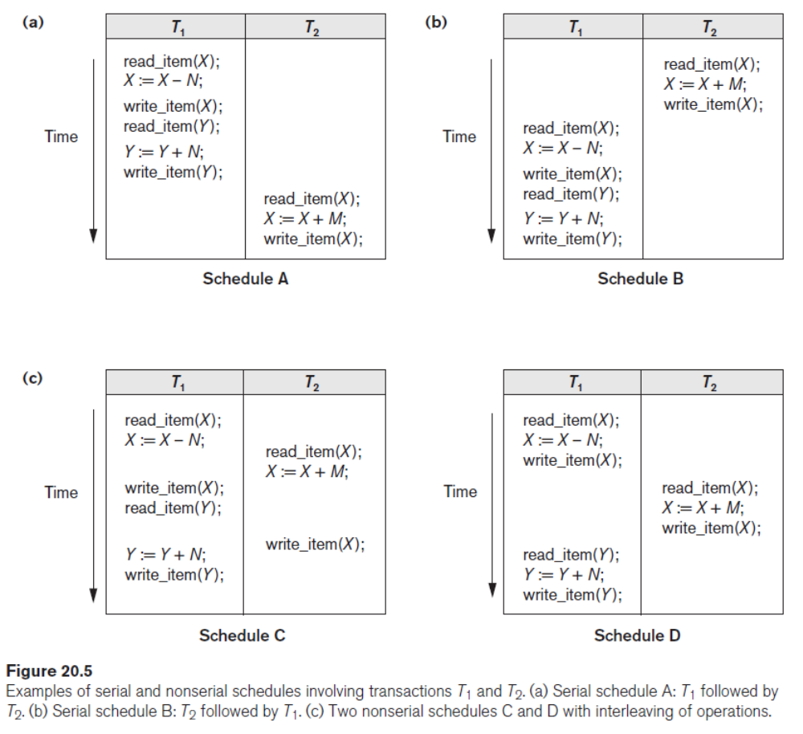
Characterizing Schedules Based on Serializability
Jagdish Bhatta
Notes:
Jagidsh Bhatta

Slide 51
Characterizing Schedules Based on Serializability
Serial, Nonserial, and Conflict-Serializable Schedules
A schedule S is serial if, for every transaction T participating in the schedule, all the operations of T are executed consecutively in the schedule; otherwise, the schedule is called nonserial. Therefore, in a serial schedule, only one transaction at a time is active—the commit (or abort) of the active transaction initiates execution of the next transaction. No interleaving occurs in a serial schedule. One reasonable assumption we can make, if we consider the transactions to be independent, is that every serial schedule is considered correct. We can assume this because every transaction is assumed to be correct if executed on its own (according to the consistency preservation property). Hence, it does not matter which transaction is executed first. As long as every transaction is executed from beginning to end in isolation from the operations of other transactions, we get a correct end result.
Schedules A and B in the figure in previous slide, Figures 20.5(a) and (b), are called serial because the operations of each transaction are executed consecutively, without any interleaved operations from the other transaction. In a serial schedule, entire transactions are performed in serial order: T1 and then T2 in the figure 20.5(a), and T2 and then T1 in Figure 20.5(b). Schedules C and D in figure 20.5(c) are called nonserial because each sequence interleaves operations from the two transactions.
Jagdish Bhatta
Notes:
Jagidsh Bhatta

Slide 52
Characterizing Schedules Based on Serializability
Serial, Nonserial, and Conflict-Serializable Schedules
The problem with serial schedules is that they limit concurrency by prohibiting interleaving of operations. In a serial schedule, if a transaction waits for an I/O\ operation to complete, we cannot switch the CPU processor to another transaction, thus wasting valuable CPU processing time. Additionally, if some transaction T is long, the other transactions must wait for T to complete all its operations before starting. Hence, serial schedules are unacceptable in practice. However, if we can determine which other schedules are equivalent to a serial schedule, we can allow these schedules to occur.
Jagdish Bhatta
Notes:
Jagidsh Bhatta

Slide 53
Characterizing Schedules Based on Serializability
Serial, Nonserial, and Conflict-Serializable Schedules
A schedule S of n transactions is serializable if it is equivalent to some serial schedule of the same n transactions. We will define the concept of equivalence of schedules shortly. Notice that there are n! possible serial schedules of n transactions and many more possible nonserial schedules. We can form two disjoint groups of the nonserial schedules— those that are equivalent to one (or more) of the serial schedules and hence are serializable, and those that are not equivalent to any serial schedule and hence are not serializable.
Saying that a nonserial schedule S is serializable is equivalent to saying that it is correct, because it is equivalent to a serial schedule, which is considered correct.
Jagdish Bhatta
Notes:
Jagidsh Bhatta

Slide 54
Characterizing Schedules Based on Serializability
Serial, Nonserial, and Conflict-Serializable Schedules
The simplest but least satisfactory definition involves comparing the effects of the schedules on the database. Two schedules are called result equivalent if they produce the same final state of the database. However, two different schedules may accidentally produce the same final state.
Hence, result equivalence alone cannot be used to define equivalence of schedules. The safest and most general approach to defining schedule equivalence is to focus only on the read_item and write_item operations of the transactions, and not make any assumptions about the other internal operations included in the transactions. For two schedules to be equivalent, the operations applied to each data item affected by the schedules should be applied to that item in both schedules in the same order.
Jagdish Bhatta
Notes:
Jagidsh Bhatta

Slide 55
Characterizing Schedules Based on Serializability
Serial, Nonserial, and Conflict-Serializable Schedules
Conflict Equivalence of Two Schedules. Two schedules are said to be conflict equivalent if the relative order of any two conflicting operations is the same in both schedules.
Two operations in a schedule are said to conflict if they belong to different transactions, access the same database item, and either both are write_item operations or one is a write_item and the other a read_item. If two conflicting operations are applied in different orders in two schedules, the effect can be different on the database or on the transactions in the schedule, and hence the schedules are not conflict equivalent.
For example, if a read and write operation occur in the order r1(X), w2(X) in schedule S1, and in the reverse order w2(X), r1(X) in schedule S2, the value read by r1(X) can be different in the two schedules. Similarly, if two write operations occur in the order w1(X), w2(X) in S1, and in the reverse order w2(X), w1(X) in S2, the next r(X) operation in the two schedules will read potentially different values; or if these are the last operations writing item X in the schedules, the final value of item X in the database will be different.
Jagdish Bhatta
Notes:
Jagidsh Bhatta

Slide 56
Characterizing Schedules Based on Serializability
Serial, Nonserial, and Conflict-Serializable Schedules
Serializable Schedules. Using the notion of conflict equivalence, we define a schedule S to be serializable if it is (conflict) equivalent to some serial schedule S′. In such a case, we can reorder the nonconflicting operations in S until we form the equivalent serial schedule S′.
Jagdish Bhatta
Notes:
Jagidsh Bhatta

Slide 57
Characterizing Schedules Based on Serializability
Jagdish Bhatta
Notes:
Jagidsh Bhatta

Slide 58
Characterizing Schedules Based on Serializability
Serial, Nonserial, and Conflict-Serializable Schedules
Schedule D in Figure 20.5(c), in previous slide, is equivalent to the serial schedule A in Figure 20.5(a). In both schedules, the read_item(X) of T2 reads the value of X written by T1, whereas the other read_item operations read the database values from the initial database state. Additionally, T1 is the last transaction to write Y, and T2 is the last transaction to write X in both schedules. Because A is a serial schedule and schedule D is equivalent to A, D is a serializable schedule. Notice that the operations r1(Y) and w1(Y) of schedule D do not conflict with the operations r2(X) and w2(X), since they access different data items. Therefore, we can move r1(Y), w1(Y) before r2(X), w2(X), leading to the equivalent serial schedule T1, T2.
Schedule C in Figure 20.5(c) is not equivalent to either of the two possible serial schedules A and B, and hence is not serializable. Trying to reorder the operations of schedule C to find an equivalent serial schedule fails because r2(X) and w1(X) conflict, which means that we cannot move r2(X) down to get the equivalent serial schedule T1, T2. Similarly, because w1(X) and w2(X) conflict, we cannot move w1(X) down to get the equivalent serial schedule T2, T1.
Jagdish Bhatta
Notes:
Jagidsh Bhatta

Slide 59
Characterizing Schedules Based on Serializability
Testing for Serializability of a Schedule
The algorithm for testing seriablizability looks at only the read_item and write_item operations in a schedule to construct a precedence graph (or serialization graph), which is a directed graph G = (N, E) that consists of a set of nodes N = {T1, T2, … , Tn } and a set of directed edges E = {e1, e2, … , em }.
There is one node in the graph for each transaction Ti in the schedule. Each edge ei in the graph is of the form (Tj → Tk ), 1 ≤ j ≤ n, 1 ≤ k ≤ n, where Tj is the starting node of ei and Tk is the ending node of ei. Such an edge from node Tj to node Tk is created by the algorithm if a pair of conflicting operations exist in Tj and Tk and the conflicting operation in Tj appears in the schedule before the conflicting operation in Tk. (Refer slide no 42 for conflicting operations)
Jagdish Bhatta
Notes:
Jagidsh Bhatta

Slide 60
Characterizing Schedules Based on Serializability
Testing for Serializability of a Schedule
Algorithm: Testing Conflict Serializability of a Schedule S
  For each transaction Ti participating in schedule S, create a node labeled Ti in the precedence graph.
  For each case in S where Tj executes a read_item(X) after Ti executes a write_item(X), create an edge (Ti → Tj) in the precedence graph.
  For each case in S where Tj executes a write_item(X) after Ti executes a read_item(X), create an edge (Ti → Tj) in the precedence graph.
  For each case in S where Tj executes a write_item(X) after Ti executes a write_item(X), create an edge (Ti → Tj) in the precedence graph.
  The schedule S is serializable if and only if the precedence graph has no cycles
If there is a cycle in the precedence graph, schedule S is not (conflict) serializable; if there is no cycle, S is (conflict) serializable. A cycle in a directed graph is a sequence of edges C = ((Tj → Tk), (Tk → Tp), … , (Ti → Tj)) with the property that the starting node of each edge—except the first edge—is the same as the ending node of the previous edge, and the starting node of the first edge is the same as the ending node of the last edge (the sequence starts and ends at the same node).
Jagdish Bhatta
Notes:
Jagidsh Bhatta

Slide 61
Characterizing Schedules Based on Serializability
In the precedence graph, an edge from Ti to Tj means that transaction Ti must come before transaction Tj in any serial schedule that is equivalent to S, because two conflicting operations appear in the schedule in that order. If there is no cycle in the precedence graph, we can create an equivalent serial schedule S′ that is equivalent to S, by ordering the transactions that participate in S as follows: Whenever an edge exists in the precedence graph from Ti to Tj, Ti must appear before Tj in the equivalent serial schedule S′.
In general, several serial schedules can be equivalent to S if the precedence graph for S has no cycle. However, if the precedence graph has a cycle, it is easy to show that we cannot create any equivalent serial schedule, so S is not serializable
Jagdish Bhatta
Notes:
Jagidsh Bhatta

Slide 62
Characterizing Schedules Based on Serializability
Jagdish Bhatta
Notes:
Jagidsh Bhatta

Slide 63
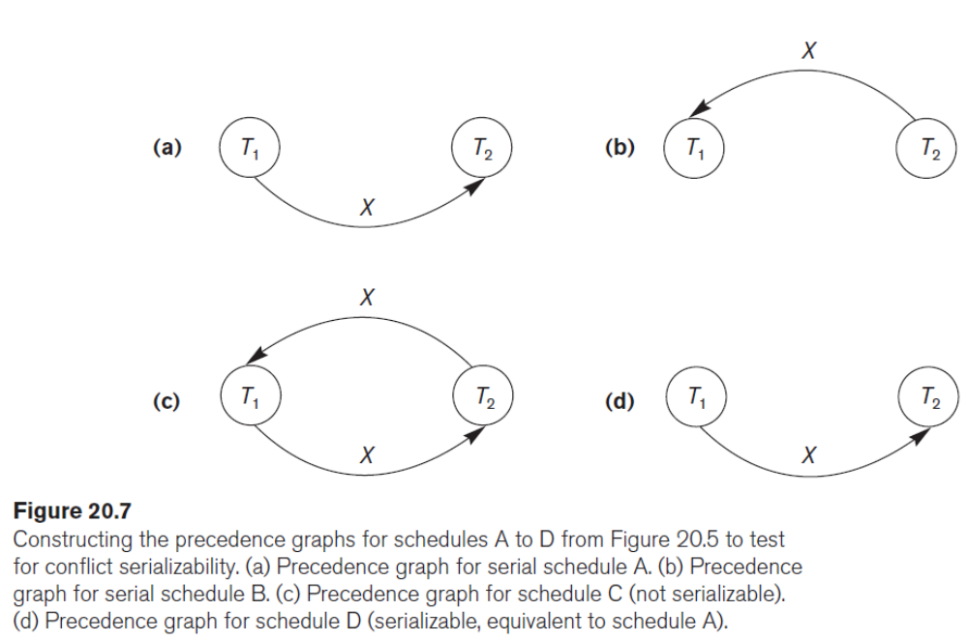
Characterizing Schedules Based on Serializability
Jagdish Bhatta
Notes:
Jagidsh Bhatta

Slide 64
Characterizing Schedules Based on Serializability
The graph for schedule C has a cycle, so it is not serializable.
The graph for schedule D has no cycle, so it is serializable, and the equivalent serial schedule is T1 followed by T2.
The graphs for schedules A and B have no cycles, as expected, because the schedules are serial and hence serializable.
Jagdish Bhatta
Notes:
Jagidsh Bhatta

Slide 65
How Serializability Is Used for Concurrency Control
Saying that a schedule S is (conflict) serializable—that is, S is (conflict) equivalent to a serial schedule—is tantamount to saying that S is correct. Being serializable is distinct from being serial, however. A serial schedule represents inefficient processing because no interleaving of operations from different transactions is permitted. This can lead to low CPU utilization while a transaction waits for disk I/O, or for a long transaction to delay other transactions, thus slowing down transaction processing considerably. A serializable schedule gives the benefits of concurrent execution without giving up any correctness.
In practice, it is difficult to test for the serializability of a schedule. The interleaving of operations from concurrent transactions—which are usually executed as processes by the operating system—is typically determined by the operating system scheduler, which allocates resources to all processes.
Jagdish Bhatta
Notes:
Jagidsh Bhatta

Slide 66
How Serializability Is Used for Concurrency Control
Factors such as system load, time of transaction submission, and priorities of processes contribute to the ordering of operations in a schedule.
Hence, it is difficult to determine how the operations of a schedule will be interleaved beforehand to ensure serializability. If transactions are executed at will and then the resulting schedule is tested for serializability, we must cancel the effect of the schedule if it turns out not to be serializable. This is a serious problem that makes this approach impractical. The approach taken in most commercial DBMSs is to design protocols (sets of rules) that—if followed by every individual transaction or if enforced by a DBMS concurrency control subsystem—will ensure serializability of all schedules in which the transactions participate.
Jagdish Bhatta
Notes:
Jagidsh Bhatta

Slide 67
How Serializability Is Used for Concurrency Control
Another problem is that transactions are submitted continuously to the system, so it is difficult to determine when a schedule begins and when it ends. Serializability theory can be adapted to deal with this problem by considering only the committed projection of a schedule S. The committed projection C(S) of a schedule S includes only the operations in S that belong to committed transactions. We can theoretically define a schedule S to be erializable if its committed projection C(S) is equivalent to some serial schedule, since only committed transactions are guaranteed by the DBMS.
Jagdish Bhatta
Notes:
Jagidsh Bhatta

